Slide 1
X22A ducted propeller Validation geometry
T.S. Vermeulen – Feb 2025

Slide 2
Contents
This pack contains the geometry of the X22A ducted propeller, used for validation of the MTFLOW (python) interface.
A hyperlink to each source is given in the slide titles
The last slide contains some information on the airfoil choice for the propeller, which, combined with slide 4, should be enough to give a (rough) reconstruction. However, full airfoil details are not known, so this remains approximate.

Slide 3
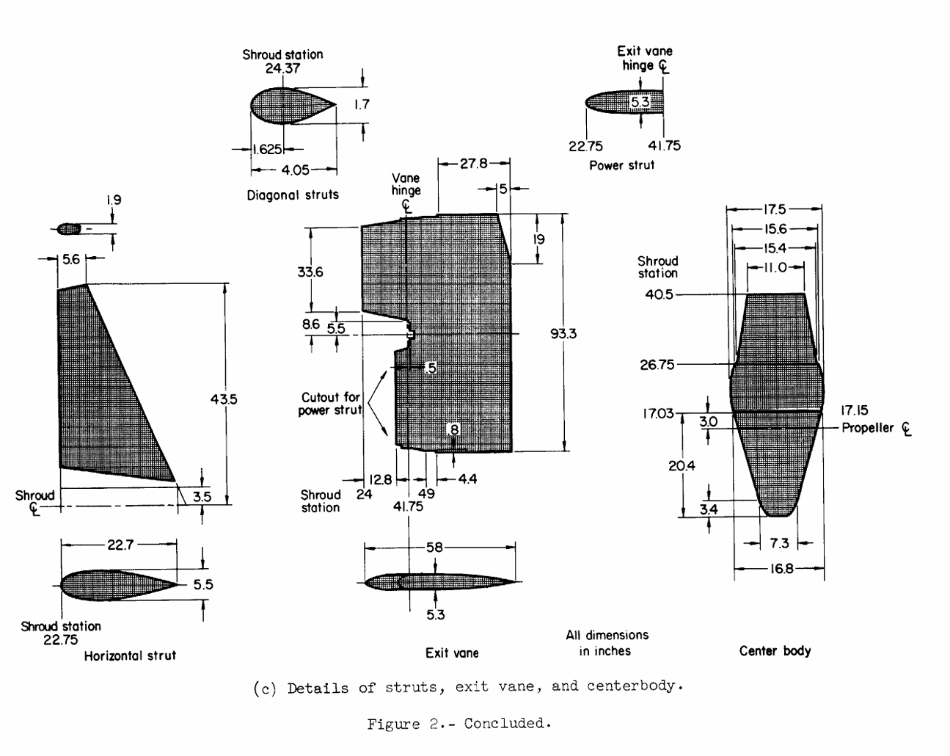
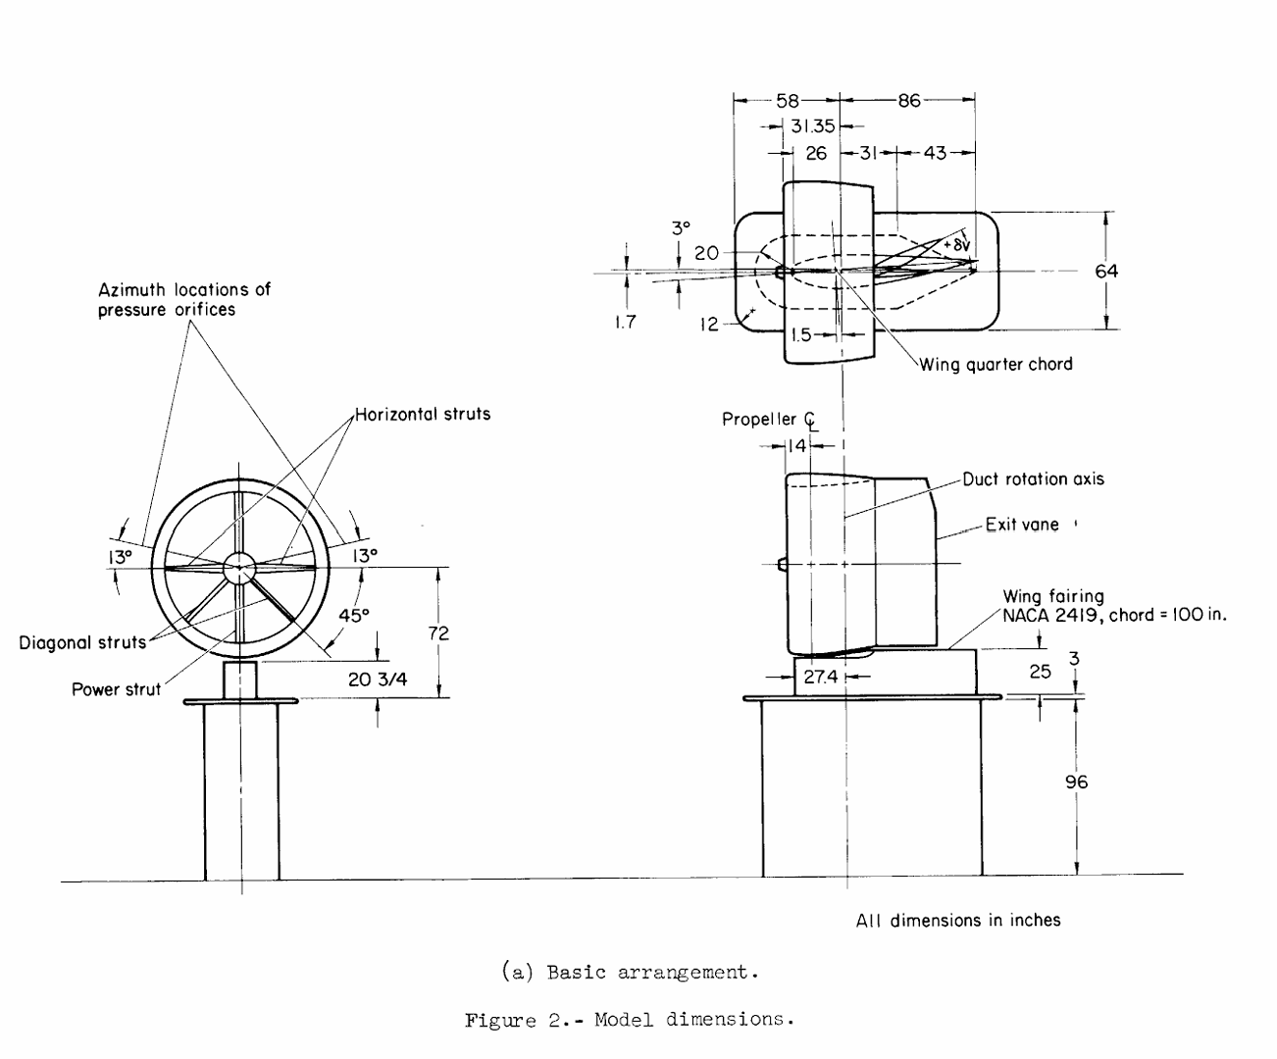
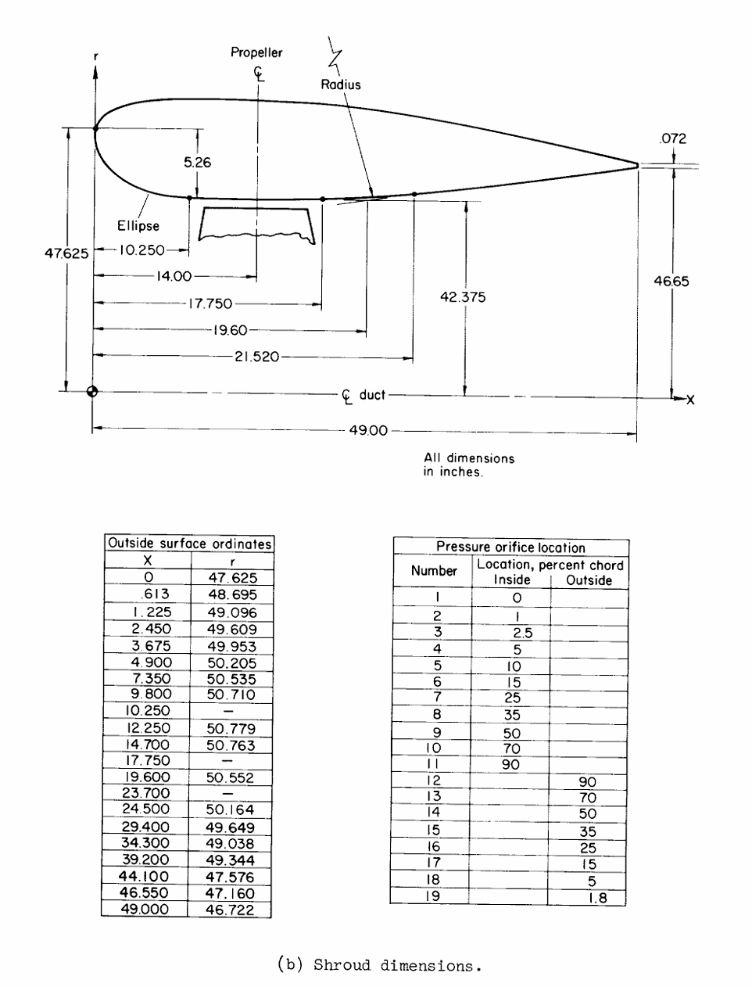
19670025554.pdf

Slide 4
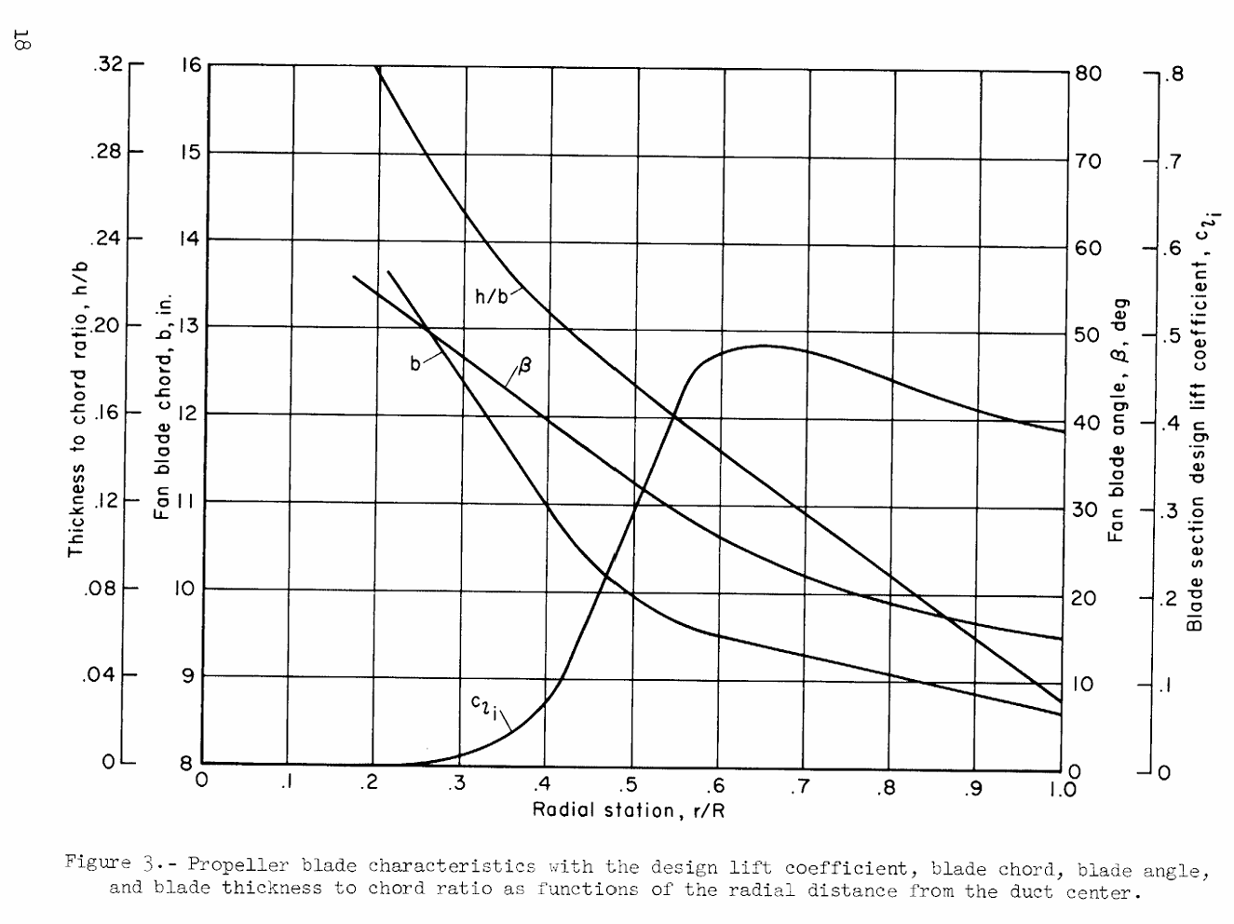
19670025554.pdf

Slide 5
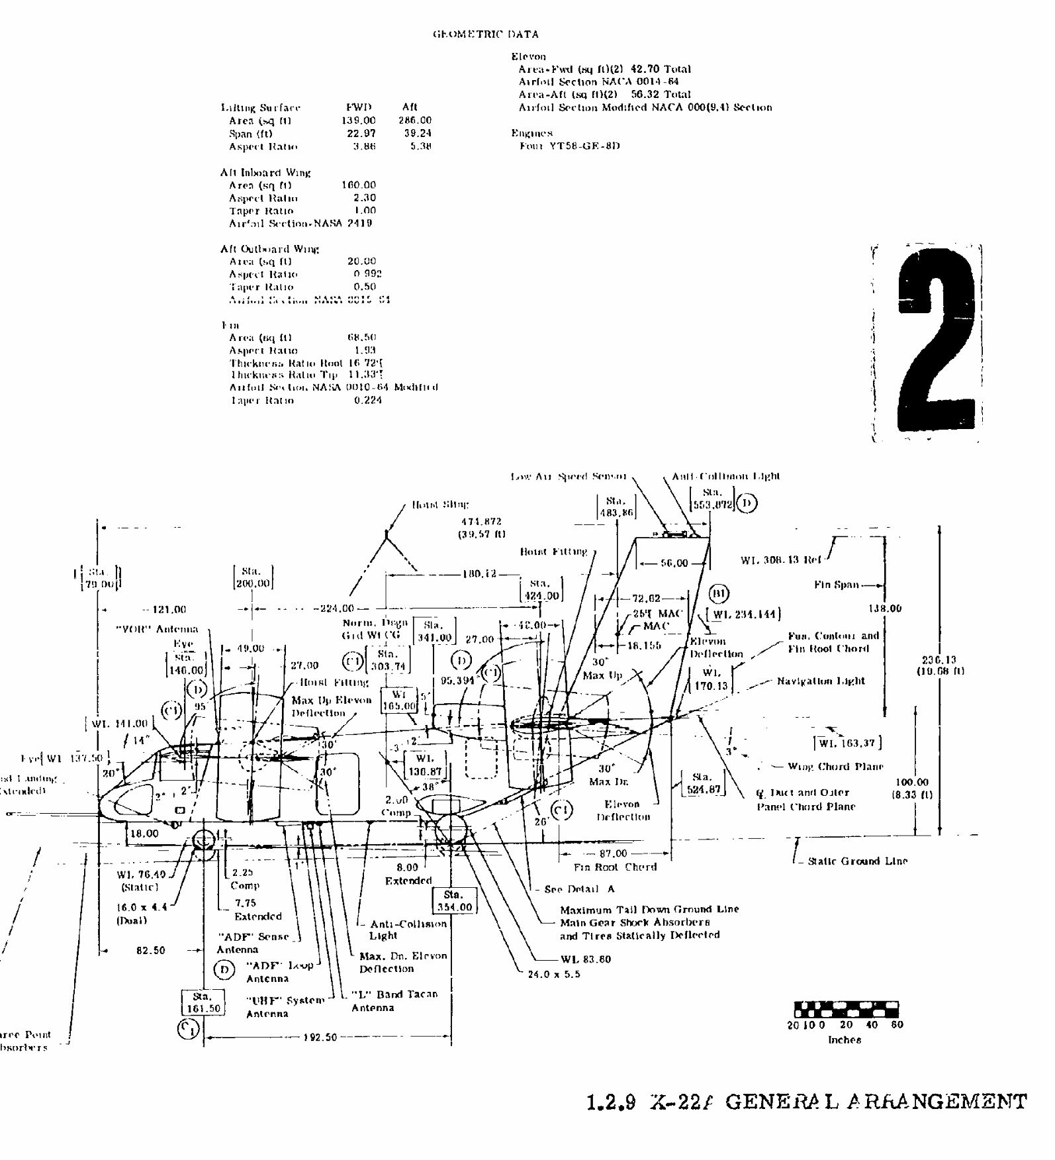
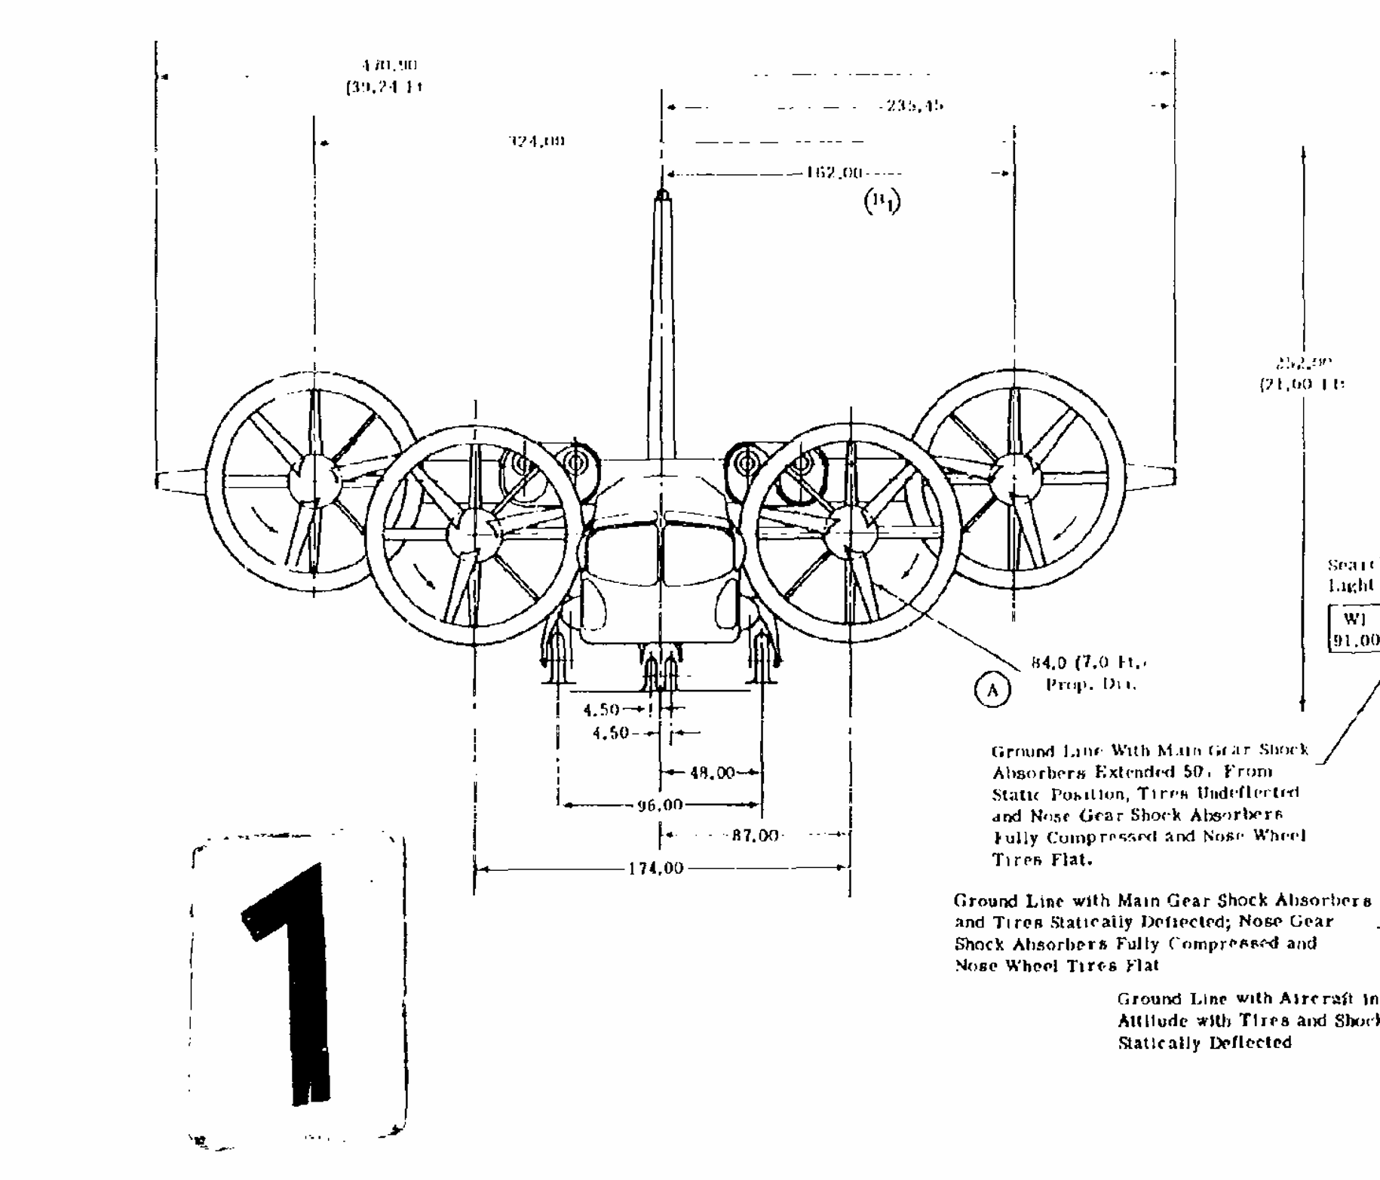
MODEL X-22A. DEMONSTRATION PLANNING AND PROGRESS REPORT
Fan Area: 68.5 sq ft
AR: 1.93
t/c root: 16.72
t/c tip: 11.33
section: nasa 0010-64 modified
Taper: 0.224

